Slide 1
Write an annotated Bibliography for the Children’s book: The Bear Came Along by Richard T. Morris

Slide 2
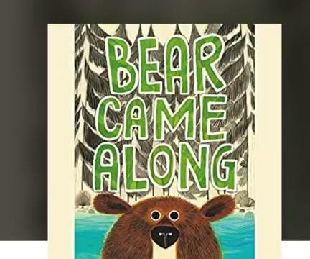
Audiobook provided below:

Slide 3
Format for Annotations:
​​McKissack, P. (2001). Goin’ someplace special. (J. Pinkney, Illus.). Atheneum Books for
Young Readers.
A citation includes:
Author (last name, first initial). Copyright date (in parentheses). Title should be italicized (only the first word and proper nouns are capitalized in the title. If there is a colon (:) in the title, the word following the colon should be capitalized). Illustrator name, if different than author; also translator name, if given. Publisher.
Don’t forget to indent the second line if your citation extends to a second line.
SUMMARY (125 WORDS OR LESS)
Set in the south during segregation, this story tells about Tricia Ann's difficulties during a trip alone across town to a special destination. Along the way she is met with prejudice and bigotry and considers giving up and going back home to Mama Frances. However, she perseveres and finally makes her way to her own "someplace special" - the public library. Here the Jim Crow laws are not in effect, and she feels welcome. Illustrator Jerry Pinkney, in his trademark impressionistic style, uses watercolor and pencils to illustrate this award-winning book.
The annotations (summaries) are to be written as if they are being added to a professional selection tool, which means they are short and concise. Include: character and age (if available) basic plot, theme(s), setting, and climactic event unique format, such as diary style writing, suggested grade or age levels–indicate which you are using. Professional annotations do not include pronouns such as “I” or “you,” nor do they include comments such as “this is a really great book.” They are sparsely descriptive. These are summaries - not retellings.
Genre & Format: Picture Book; Historical Fiction
Suggested Age or Grade Level(s): Grades 2 – 6
Awards: 2002 Coretta Scott King Illustrator Award
2003-2004 Texas Bluebonnet Award nominee
Booklist Starred Review
2002 Notable Children’s Book List
PERSONAL REFLECTION OR REVIEW
Goin’ Someplace Special would be very appealing to an upper elementary age student because most children struggle with issues of feeling accepted. The watercolor illustrations in this book add to the appeal. This book could be used in intermediate or high school settings along with a historical study of integration. I would definitely recommend this book because students can easily relate to it and because it can be used for teaching about a specific historical time period.
Your thoughts as a professional educator on this book, child appeal, literary quality, anything special or outstanding, how this book can be used in an educational setting; Would you recommend this book for children? Why or why not?

